Slide 1

NUSC Summer School
Topic Modelling for Literature Review
Using Python programming language
Contact Details:
Dr. James Duong quang.duong@gre.ac.uk

Slide 2
Learning Outcomes
At the end of this session, participants will be able to:
Holistically diagnose the sources of noises and challenges from unstructured abstract data - (Session 1)
Design a customised pipeline of text processing methods to address the noises and produce a ready-to-use collection of documents (i.e., corpus) - (Session 1-2)
Employ topic modelling for identifying the prevailing themes in your research domain - (Session 2-3)
Visualise the extracted topics on a semantic space - (Session 2-3)
Notes:
About With the proliferation of academic databases, manual thematic/content analysis is no longer effective to cover all papers and extract common topics. To cope with that issue, machine learning-based topic modelling is a well-known technique to explore prominent topics from a big collection of texts. This course aims to provide a basic knowledge about text pre-processing and an introduction of the most common topic model – Latent Dirichlet Allocation (LDA) using the Python-programming language. The participants will have an opportunity to practise on real academic dataset.

Slide 3
Session 1. Getting started and Text Cleaning
Agenda
Warm-up (10 mins)
Theory – Why is text cleaning and pre-processing utmost important? (10 mins)
Setting up the environment (5 mins)
Data collection & inspection from Scopus and Web of Science (25 mins)
Basic text data cleaning (20 mins)
Practice in your own data (20 mins)

Slide 4
Session 2. Text Transformation
Agenda
Create Bigram and Trigram model (10 mins)
Remove stop words (10 mins)
Lemmatisation vs. Stemming (10 mins)
Cleaning practice (30 mins)
Short introduction of topic modelling and LDA (30 mins)

Slide 5
Session 3. Topic Modelling and Outcomes
Agenda
Recap questions (10 mins)
Training model and some important parameters(10 mins)
Hyperparameter Tuning – Select the best number of topics (10 mins)
Extracting and visualising outcomes (20 mins)
10-minute break
A full pipeline of topic modelling from scratch (60 mins)

Slide 6
Session 1. Getting started and Text Cleaning
Agenda
Warm-up (10 mins)
Theory – Why is text cleaning and pre-processing utmost important? (10 mins)
Setting up the environment (5 mins)
Data collection & inspection from Scopus and Web of Science (25 mins)
Basic text data cleaning (20 mins)
Practice in your own data (20 mins)

Slide 7

Warm-up activities with Menti (10 mins)
Join at menti.com use code 6190 9269

Slide 8
1. The importance of data cleaning and processing (10 mins)

Slide 9
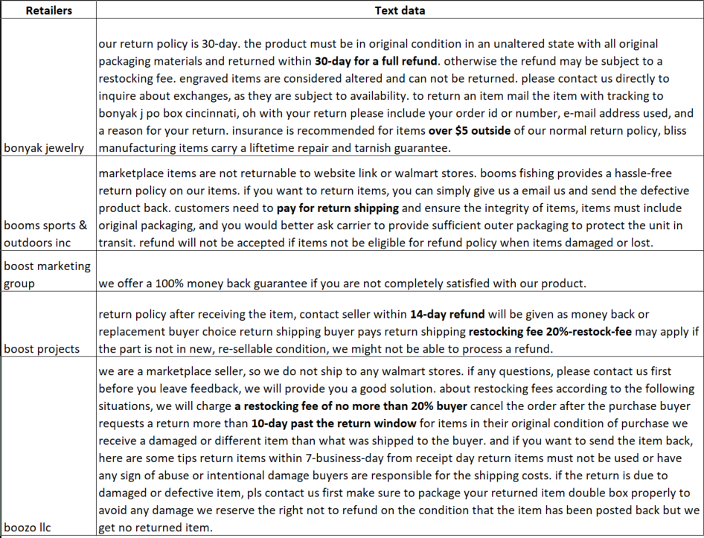
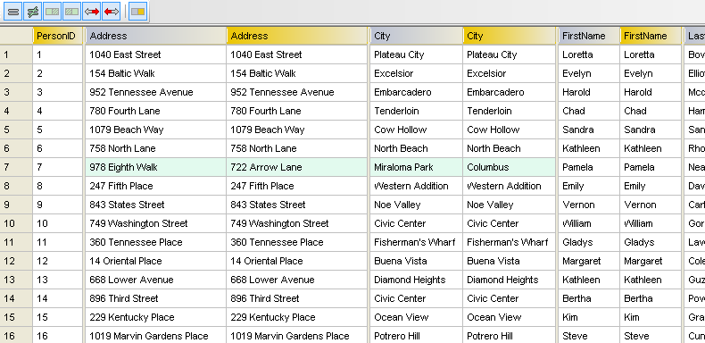
1. Structured vs. Unstructured data
What are the differences between them?
Structured data
Unstructured data
Notes:
Unstructured text data refers to textual information that does not follow a specific format or organization. It typically lacks a predefined structure, making it challenging to analyze and extract meaningful insights directly.

Slide 10
1. Structured vs. Unstructured data
What are the differences between them?
Structured data
Unstructured data
Format: predefined format, often represented in tables, databases, or spreadsheets.
Data Types: Structured data is characterised by fixed data types such as numbers, dates, Boolean values, and categorical variables.
Querying: Structured data can be easily queried allowing for efficient retrieval, filtering, and aggregation of specific information.
Analysis: Analysing structured data often involves traditional data analysis techniques, including statistical analysis, mathematical modelling, and machine learning algorithms.
Format: lacking a predefined format or organization. It comprises natural language text, paragraphs, sentences, and words without explicit field definitions.
Data Types: Text data primarily consists of alphanumeric characters, words, and sentences.
Querying: Challenging due to the diversity of language. E.g., address format
Analysis: requires techniques specific to natural language processing (NLP), such as text classification, sentiment analysis, topic modelling, named entity recognition, and information extraction.
Notes:
It consists of well-defined fields, columns, and rows, with each data point having a specific data type.
Un – data types - The content may include text in multiple languages, special characters, punctuation marks, and other linguistic elements.
Analysis: NLP methods focus on understanding the meaning, sentiment, and context of the text.

Slide 11
1. Structured vs. Unstructured data
What are the challenges of text processing?
Processing Challenges:
Language ambiguity
Spelling and grammar variations, noise, errors e.g., special characters, punctuations.
Synonyms
Colloquialisms and slang
Context-dependent interpretations.
Contextual Understanding: Text data analysis often requires context awareness (e.g., domain-specific language) and semantic understanding to capture nuanced meanings, sarcasm, irony, or cultural references.
Same word with different meanings:
I ran to the store because we ran out of milk/Can I run something past you real quick?/The house is looking really run down.
Notes:
Text data presents unique challenges due to its unstructured nature, including
Text preprocessing techniques, such as cleaning, tokenization, stemming, and lemmatization, are necessary to address these challenges.
NLP models and techniques aim to capture the richness of human language.

Slide 12
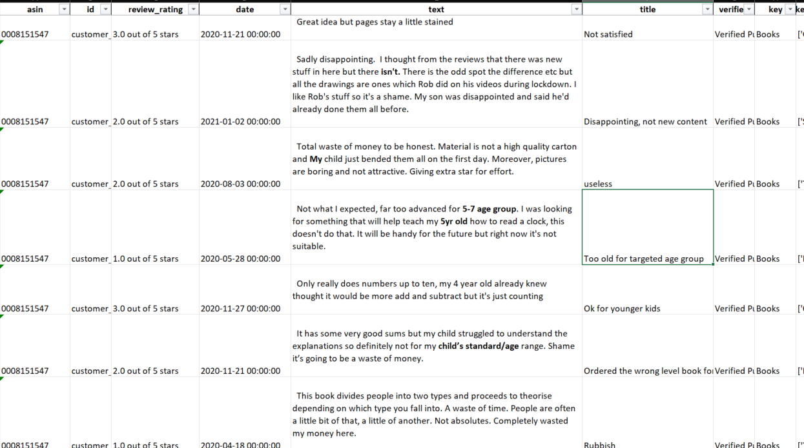
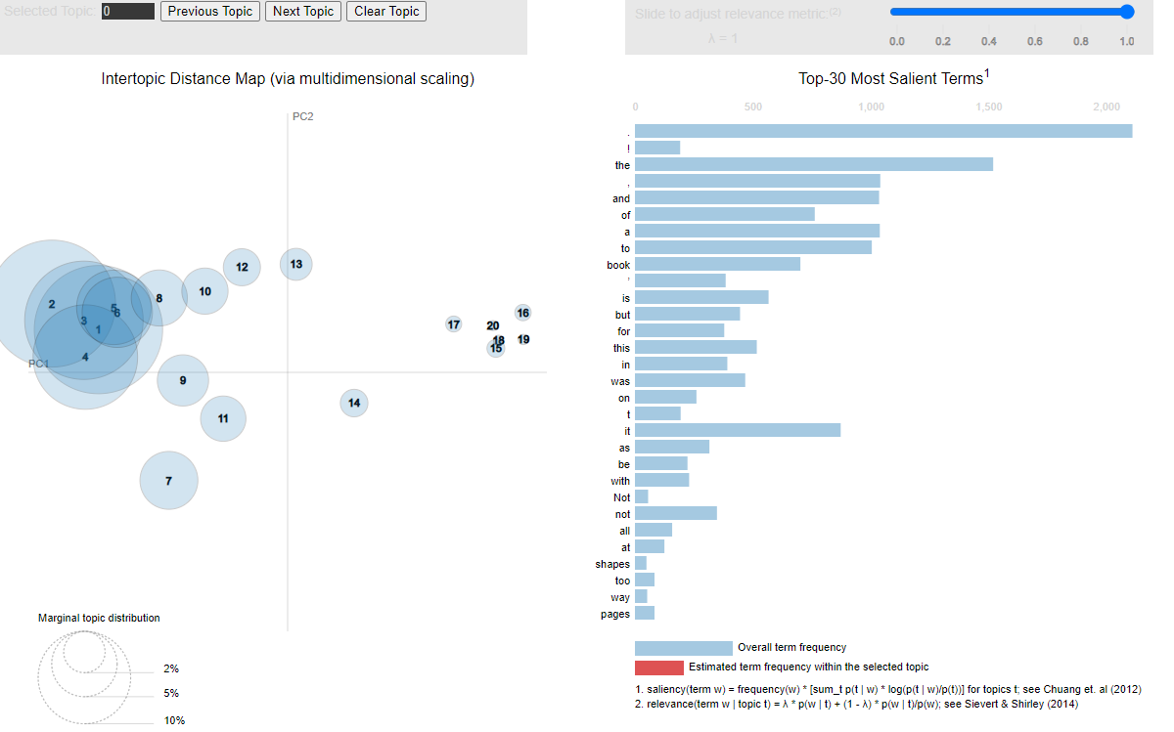
1. Structured vs. Unstructured data
Examples of generating a topic model without text pre-processing
1000 Amazon customer reviews
With text cleaning and pre-processing
Apply LDA topic modelling

Slide 13
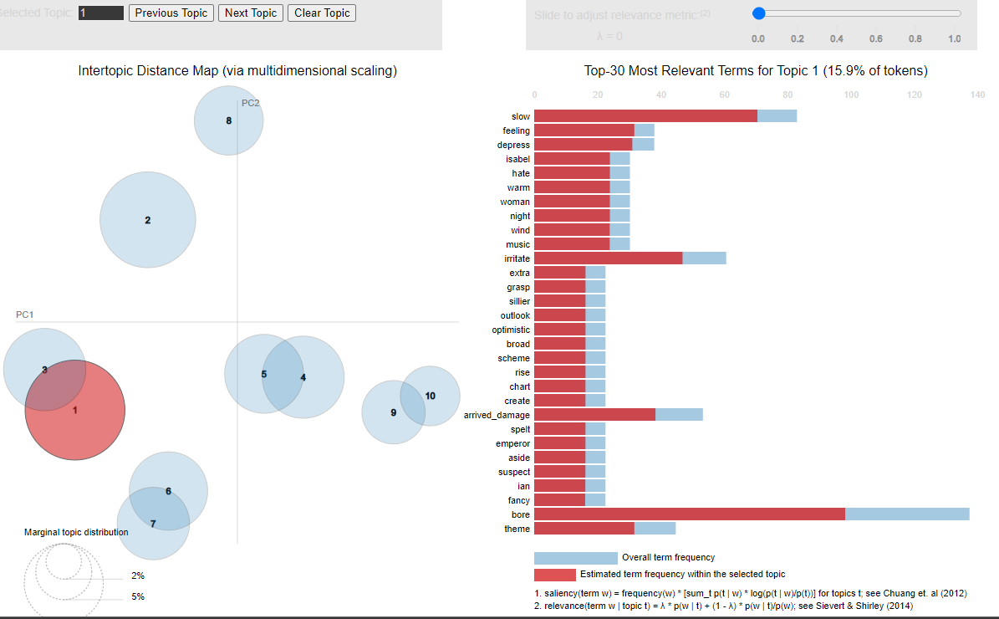
1. Structured vs. Unstructured data
Examples of generating a topic model without text pre-processing
1000 Amazon customer reviews
With text cleaning and pre-processing
Apply LDA topic modelling

Slide 14
2. Setting up the environment (10 mins)

Slide 15





2. Anaconda and Jupyter Notebook
An interactive computing platform:
Other options: Google Colab, Spyder, Pycharm, Terminal.
Source: Clyde Kluckhohn, 1961
Notes:
Culture has been defined as the configuration of learned behaviour and results of behaviour whose component elements are shared and transmitted by members of a particular society.
The below have some advantages:
Use the power of your computer
Script composer and console are separated
Static in terms of package, easy to customise the Python package based on your own use
Google Colab – may make your code easily outdated, keep the version of your results
Advantages
No use of your computer, protect your computer
Can use your google drive data
Quick and easy to access
Package can be automatically updated

Slide 16
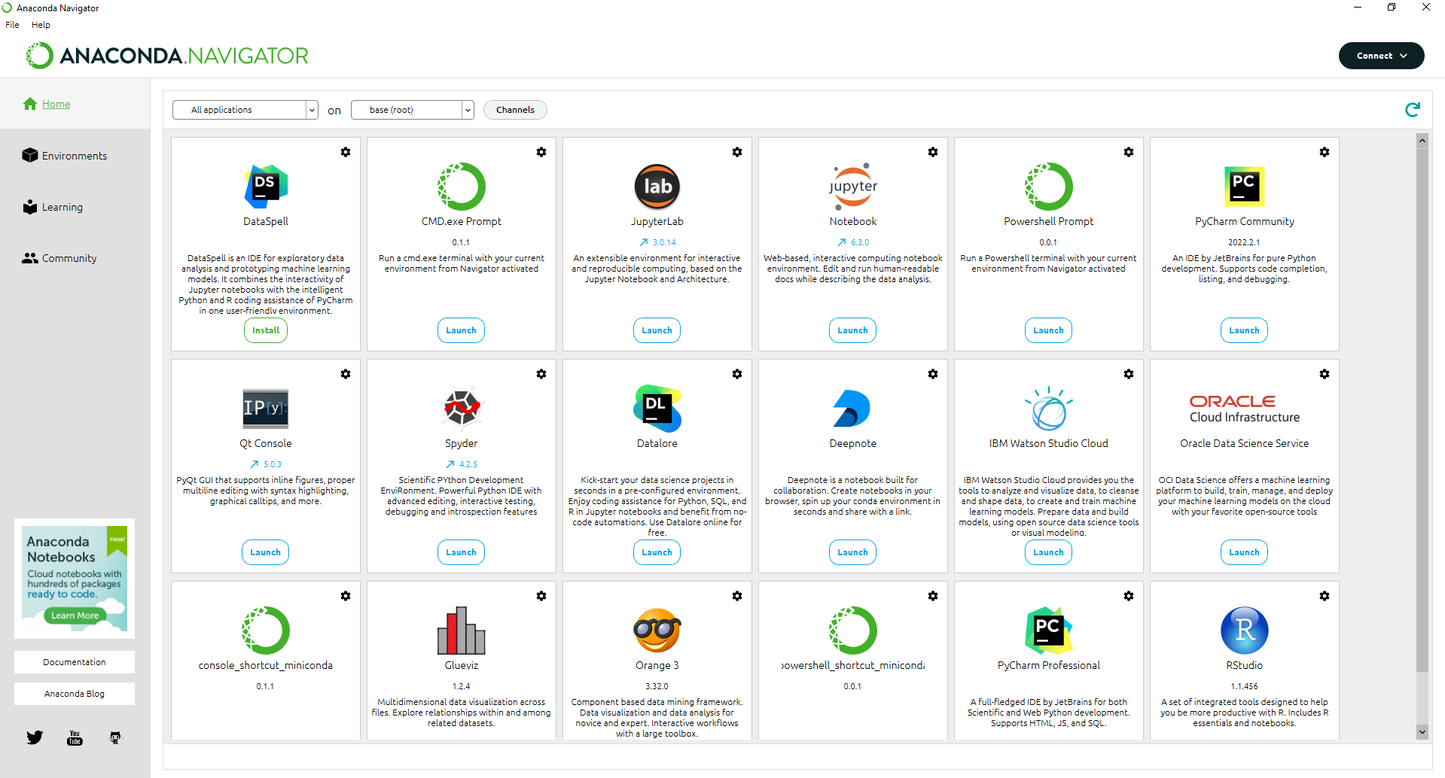
2. Anaconda and Jupyter Notebook
Setting up…
Notebook: Location for creating and loading new notebooks, save data, etc
Jupyterlab: Directly create a new notebook

Slide 17
2. Anaconda and Jupyter Notebook
Find the direction of your notebook
Change the direction of your notebook
Introduction of some functions in Jupyter Notebook
Upload and download area
Check installed packages
Add code and text cells
Move cells
Install some necessary packages through Anaconda
Some shortcuts on keyboard

Slide 18
Get my code and data sample…
https://github.com/quanghuy2506/NUSC-LDA.git

Slide 19
3. Loading data and inspecting dataset (15 mins)

Slide 20
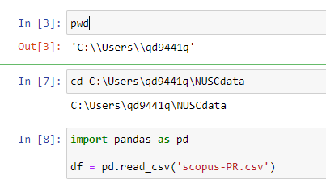
3. Loading data using Pandas
Collect data from Scopus: https://www.scopus.com/search/form.uri?display=basic#basic
Upload to Jupyter Notebook or your local folder
Load data – pd.read_csv/pd.read_excel
Inspect the datasets
.info(); .isna().sum(); .head(); .columns
pd.set_option('display.max_columns', None)
Merging
Select a column(s): df1[[list of columns]]
Rename columns: df1.columns = []
Merging: pd.concat() https://pandas.pydata.org/docs/user_guide/merging.html
Remove duplications
Use Title (lower the title)
df['Title'] = df['Title'].str.lower()
df[df.duplicated(subset=['Title'], keep=False) == True].sort_values(by='Title’)
index_drop_title = df[df.duplicated(subset=['Title'], keep='first') == True].index
Df = df.drop(index_drop_title, axis='index')
Use DOI
df.dropna(subset=['DOI'], axis=0)[df.dropna(subset=['DOI'], axis=0).duplicated(subset=['DOI'], keep=False) == True].sort_values(by='DOI’)
Notes:
TITLE-ABS-KEY ( "product return" OR "return policy" ) AND PUBYEAR > 2000
WoS: (AB = ("product return" OR "return policy")) OR (TS=("product return" OR "return policy")) OR (TI =("product return" OR "return policy"))
https://pandas.pydata.org/docs/reference/api/pandas.read_csv.html
https://pandas.pydata.org/getting_started.html
If you have your own request of inspection, let me know

Slide 21
4. Text cleaning and pre-processing (30 mins)
Run the text pre-processing on the abstracts
Same approach can be applied to the full text but requires more inspections and more customised functions

Slide 22
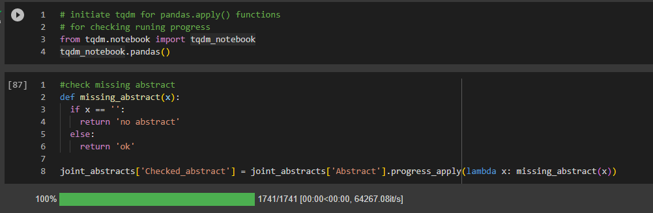
Check missing values and define a customised function

Slide 23
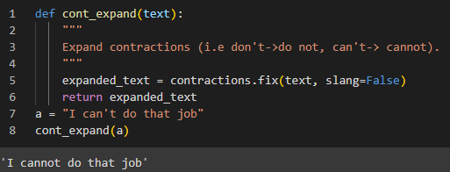
Expand Contractions

Slide 24
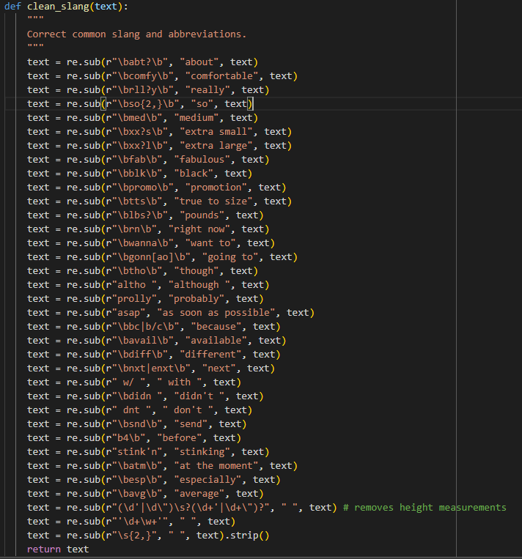
Convert abbreviations using Regex rules
Import Regex as re
Use the command:
re.sub(pattern, new_text, sentence)
\b at the beginning and the end to capture that word separately rather a part of a word
You can customise more if you want to.

Slide 25
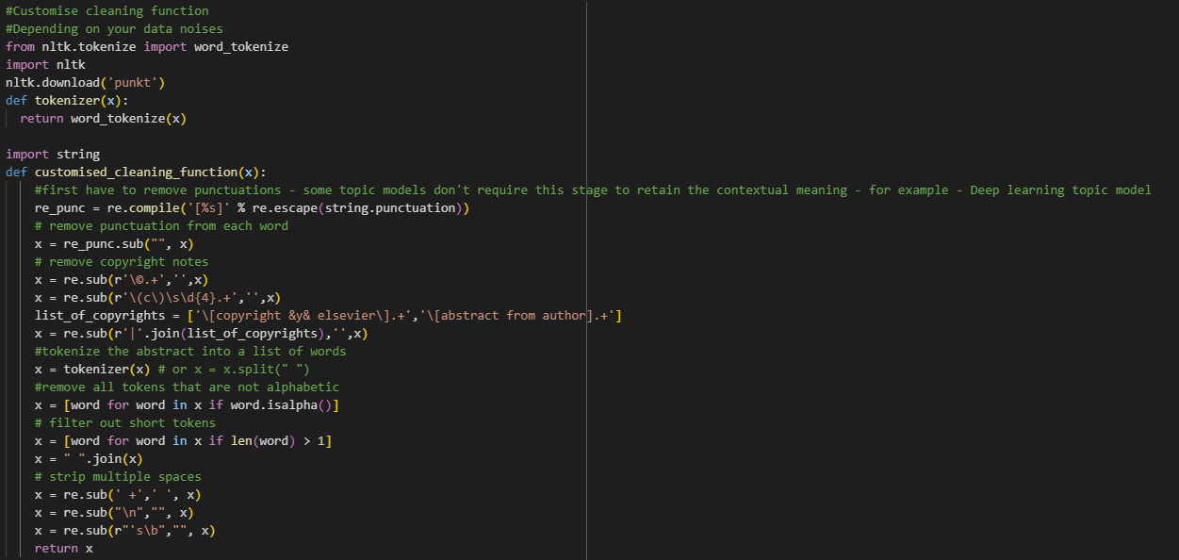
Customise a cleaning function
Remove punctuations
Remove copyright notes
Tokenize the abstract to a list of words
Remove tokens/words that are not alphabetic or short tokens
Remove multiple spaces, extra line, etc.

Slide 26
Built-in pre-processing function from Gensim

Slide 27
Practice with your own data

Slide 28
15-minute break

Slide 29
Session 2. Text Transformation
Agenda
Create Bigram and Trigram model (10 mins)
Remove stop words (10 mins)
Lemmatisation vs. Stemming (10 mins)
Cleaning practice (30 mins)
Short introduction of topic modelling and LDA (30 mins)

Slide 30
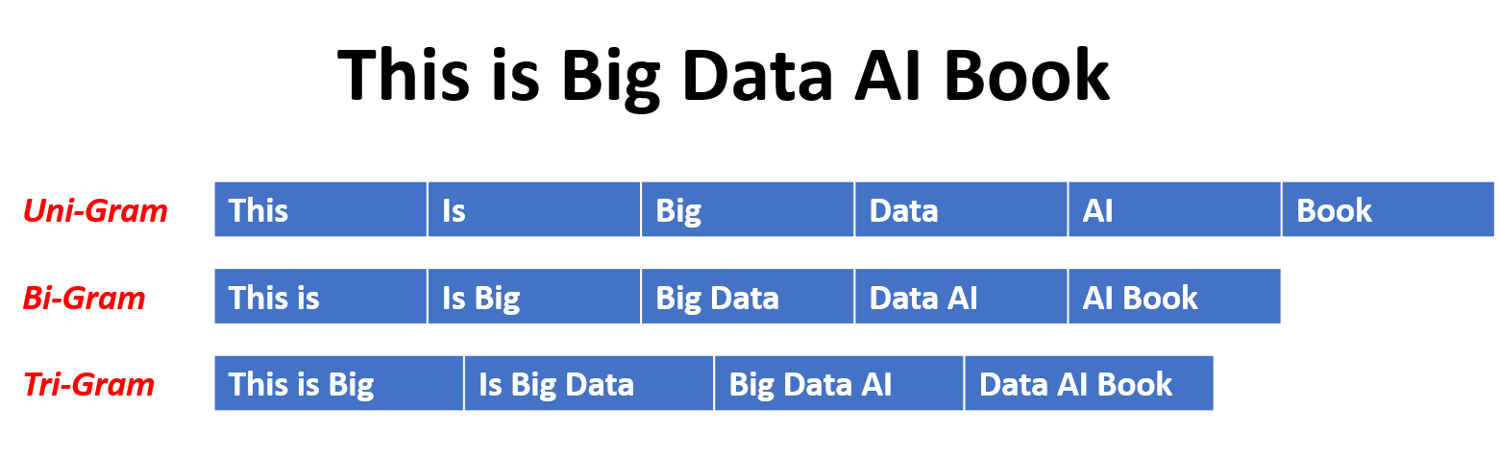
Learn the bigrams and trigrams from the datasets
An n-gram is a contiguous sequence of n items, where an item can be a word, a character, or even a phoneme, depending on the application.
How does it work?
Notes:
N-gram models are built based on the assumption that the probability of an item appearing in a sequence depends only on the history of the preceding n-1 items. This assumption is known as the Markov property. By analyzing large collections of text, n-gram models can estimate the probabilities of different n-grams occurring, which can be used to generate text, predict the next word in a sentence, or even evaluate the fluency of a sentence.
N-gram models are relatively simple but can be effective in many NLP tasks. However, they have limitations, such as the inability to capture long-range dependencies and difficulties with rare or unseen n-grams. To address these limitations, more advanced models, such as recurrent neural networks (RNNs) and transformers, have been developed.

Slide 31
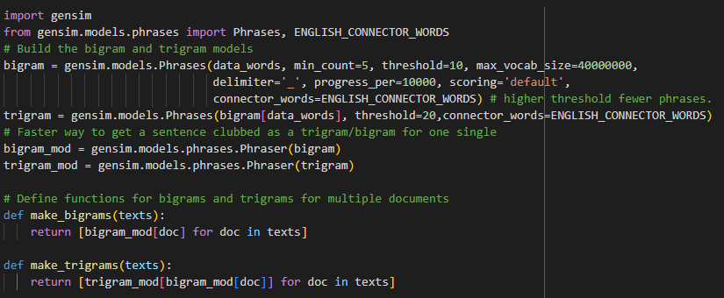
Code for bigram and trigram (Collocation detection)
Using Gensim Phrases to capture bigram and trigram
Using gensim.models.phrases.Phraser to generate trained functions that can be use to detect bigram or trigram.
Notes:
ENGLISH_CONNECTOR_WORDS: Set of words that may be included within a phrase, without affecting its scoring. No phrase can start nor end with a connector word; a phrase may contain any number of connector words in the middle.

Slide 32
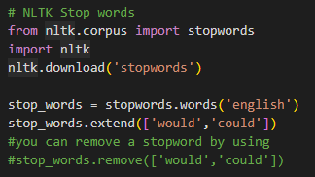
Remove stop words
What are stop words? Why do we need to remove it? Do we really need to remove them?
In natural language processing (NLP), stop words refer to commonly occurring words that are typically removed from text during pre-processing.
These words are considered to have little or no contribution to the overall meaning of a sentence or document and are often used to improve computational efficiency and focus on more informative terms.
Stopwords typically include words such as "a," "an," "the," "is," "and," "or," and other frequently used function words and prepositions
Notes:
Stopwords typically include words such as "a," "an," "the," "is," "and," "or," and other frequently used function words and prepositions. However, the specific set of stopwords can vary depending on the application and language being analyzed.
The main purpose of removing stopwords is to reduce noise in the text data and focus on the more significant words or terms that carry more meaning. By eliminating stopwords, the remaining words can better represent the underlying content and allow for more accurate analysis and processing. Stopword removal is often performed as a preprocessing step in tasks such as text classification, information retrieval, and sentiment analysis.
It's worth noting that the decision of which words to consider as stopwords can depend on the context and the specific analysis being performed. In some cases, certain stopwords might carry significance and removing them could result in the loss of important information. Therefore, it's important to carefully consider the impact of removing stopwords in a given NLP task.

Slide 33
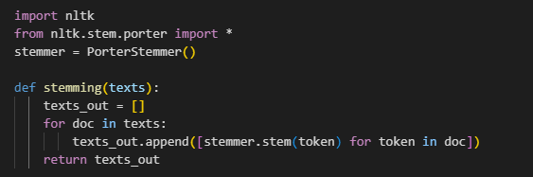
Porter Stemming
Porter stemming is a popular algorithm for stemming, which is the process of reducing words to their base or root form.
Notes:
Whether stemming or lemmatizing is better depends on the specific task and the requirements of the application. Both techniques aim to reduce words to their base form, but they approach it differently.
Stemming: Stemming typically involves applying a set of rules to truncate the ends of words to their common root form. This process can be fast and computationally efficient. However, stemming algorithms may not always produce actual words, and they can sometimes result in over-stemming. For example, "running," "runs," and "ran" would all be stemmed to "run," but "ran" has a different tense and meaning from "run.“
Lemmatizing: Lemmatization, on the other hand, involves determining the base or dictionary form of a word (called a lemma) based on its part of speech. It takes into account the context and meaning of the word and uses morphological analysis. Lemmatization generally produces valid words that exist in the language. For example, "running," "runs," and "ran" would all be lemmatized to "run."

Slide 34
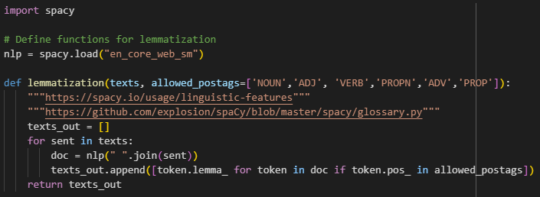
Lemmatisation
Lemmatization is a linguistic and natural language processing (NLP) technique that aims to reduce words to their base or dictionary form, known as the lemma. The lemma is the canonical or base form of a word, which represents its morphological root and carries the essential meaning of the word.
In English, for example, lemmatization would transform words like "running," "runs," and "ran" into their common lemma "run." Similarly, "cats" would be lemmatized to "cat," "better" to "good," and so on.
Notes:
https://github.com/explosion/spaCy/blob/master/spacy/glossary.py
Lemmatization goes beyond simple stemming, which chops off prefixes or suffixes to derive a word's root form. Unlike stemming, lemmatization considers the context and part of speech (POS) of a word to determine its lemma. This context-aware approach helps maintain the grammatical integrity of the text.
Lemmatization is valuable in various NLP tasks such as text classification, information retrieval, machine translation, and sentiment analysis. By reducing words to their lemmas, the vocabulary size can be reduced, which can enhance text analysis, feature extraction, and improve the performance of downstream algorithms.
Lemmatization can be performed using rule-based systems that rely on morphological analysis and dictionaries or using machine learning algorithms. Popular lemmatization libraries in Python include NLTK (Natural Language Toolkit), spaCy, and Stanford CoreNLP.
Lemmatization and Porter stemming are both techniques used in natural language processing (NLP) to reduce words to their base forms. While they have similar objectives, there are several key differences between lemmatization and Porter stemming:
Accuracy: Lemmatization aims to reduce words to their canonical or dictionary form (lemma) based on the word's part of speech (POS) and context. It produces more accurate results because it considers the linguistic rules and meaning of the word. On the other hand, Porter stemming applies a set of heuristic rules to chop off prefixes and suffixes, which may result in the stemming of words to non-dictionary forms or stems that are not actual words.
POS and context: Lemmatization takes into account the part of speech of a word, such as noun, verb, adjective, or adverb, and performs analysis accordingly. It ensures that the lemmatized form maintains grammatical integrity. Porter stemming, on the other hand, does not consider POS or context and applies generic rules to strip affixes from words. This can lead to the production of stems that may not be actual words.
Vocabulary reduction: Lemmatization typically reduces words to their base forms or dictionary forms, which results in a more controlled and consistent vocabulary. Since Porter stemming focuses on the removal of affixes, it can generate a larger variety of word forms or stems, which may not always be valid words. This can result in a less controlled vocabulary.
Computational complexity: Lemmatization can be computationally more expensive compared to Porter stemming. Lemmatization often requires access to linguistic resources such as POS tags and lexicons to accurately determine the lemma. In contrast, Porter stemming applies a set of predefined rules that can be implemented more efficiently.
In summary, lemmatization is a more linguistically informed approach that considers the context, POS, and meaning of words to generate accurate base forms. Porter stemming, while computationally efficient, applies simpler heuristic rules to strip affixes and may produce non-dictionary stems. The choice between lemmatization and Porter stemming depends on the specific requirements of the NLP task and the trade-off between accuracy and computational efficiency.

Slide 35
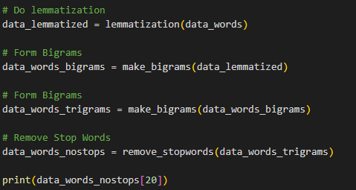
Applying these techniques…

Slide 36
Part B: Topic Modelling Latent Dirichlet Allocation

Slide 37
1. The theory (30 mins)

Slide 38
Theoretical Aspects
A corpus can be represented under the below matrix…
 | Abstract 1 | Abstract 2 | Abstract 3 | … | Abstract m
Word 1 | 1 | 0.6 | 0.4 | … | 1
Word 2 | 0.5 | 0.55 | 0 | … | 0.5
Word 3 | 0.3 | 0.36 | 1 | … | 0.2
… | … | … | … | … | ….
Word n | 0 | 0 | 1 | … | 0.5
Notes:
TF-IDF is scored between 0 and 1. The higher the numerical weight value, the rarer the term. The smaller the weight, the more common the term.
TF-IDF stands for Term Frequency-Inverse Document Frequency. It is a numerical statistic used in natural language processing (NLP) to evaluate the importance of a term within a document or a collection of documents.
TF (Term Frequency) measures the frequency of a term within a document. It indicates how often a term appears in a document relative to the total number of words in that document. A higher TF value suggests that a term is more relevant or important within the document.
IDF (Inverse Document Frequency) measures the rarity or uniqueness of a term across a collection of documents. It quantifies how much information a term provides by considering the number of documents in the collection that contain the term. A higher IDF value indicates that a term is less common and potentially more significant in distinguishing documents.
The TF-IDF score is obtained by multiplying the TF value of a term in a document by its IDF value across the entire collection of documents. This helps in highlighting terms that are frequent within a document but relatively rare across the entire collection, thus capturing their uniqueness.
The purpose of TF-IDF is to identify important terms that can help characterize or differentiate documents in a collection. It is commonly used in various NLP tasks such as information retrieval, document classification, keyword extraction, and text mining. By giving higher weights to terms that are more relevant and discriminative, TF-IDF allows for better representation and analysis of text data.

Slide 39
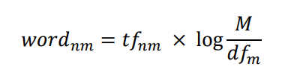
Theoretical Aspects
We start with the basic Latent Semantic Indexing (LSI), let m^{th} is document^{th} ∈ M documents, n^{th} is word^{th} ∈ N vocabulary in all documents (i.e., corpus).
The occurring probabilities of words across different documents can be calculated by a term frequency – inverse document frequency (TF-IDF) method as follow:
Notes:
LSI (Dumais et al., 1988; Deerwester et al., 1990) is the pioneer model in topic modelling field and ushers in an era of probabilistic model. LSI analyses the connections between a document in a corpus and the tokens the document contains. It assumes that words in similar text will have close meanings with each other. The model creates a matrix ± called a document term matrix wherein rows are unique words of the corpora (i.e., list of vocabulary) and columns represent documents. Let mth is review-th ∈ M reviews, nth is word-th ∈ N vocabulary in all documents, a document-term matrix A mxn (see Table 5.2) has values which are the occurrence probabilities of words across different documents, calculated by a term frequency ± inverse document frequency (TF-IDF) method as follow.
we might count the number of times each term occurs in each document; the number of times a term occurs in a document is called its term frequency
Hence, an inverse document frequency factor is incorporated which diminishes the weight of terms that occur very frequently in the document set and increases the weight of terms that occur rarely. It is the logarithmically scaled inverse fraction of the documents that contain the word (obtained by dividing the total number of documents by the number of documents containing the term, and then taking the logarithm of that quotient)

Slide 40
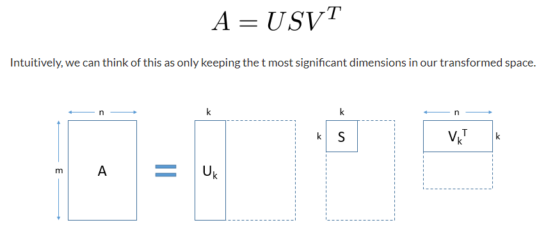
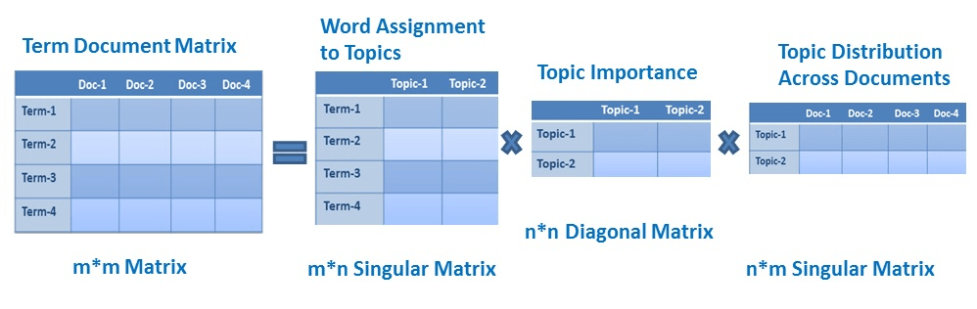
The extraction of topics
Singular Value Decomposition (SVD): SVD is a matrix factorisation technique that decomposes the TF-IDF matrix into three matrices: U, Σ, and V^T.
U represents the document-topic matrix, Σ is a diagonal matrix containing singular values (representing importance), and V^T is the term-topic matrix. SVD helps to capture the underlying latent semantic structure of the documents.
U
Σ
V^T
t*t Diagonal Matrix
m*n Matrix
n*m Singular Matrix
m*t Singular Matrix
Notes:
The idea of SVD is finding the most valuable information and using lower dimension t to represent the same thing. Singular Value Decomposition is a technique in linear algebra that factorizes any matrix A into the product of 3 separate matrices. It has many useful applications in many domains such as signal processing, psychology, sociology, climate, and atmospheric science, statistics, and astronomy. It decomposes the matrix into three different matrices.
Intuitively, we can think of this as only keeping the t most significant dimensions in our transformed space.
LSA is a technique that uses singular value decomposition (SVD) to reduce the dimensionality of the term-document matrix. It is based on the assumption that words that are used in similar contexts will have similar meanings. LSA creates a lower-dimensional representation of the text that captures the underlying relationships between the words
https://www.analyticsvidhya.com/blog/2021/06/part-16-step-by-step-guide-to-master-nlp-topic-modelling-using-lsa/

Slide 41
What are disadvantages of that approach?
Sparse matrix
Computationally expensive
Lack of interpretable embeddings (only capture the co-occurrence)
Need for a really large set of documents and vocabulary to get accurate results.
It provides less efficient representation

Slide 42
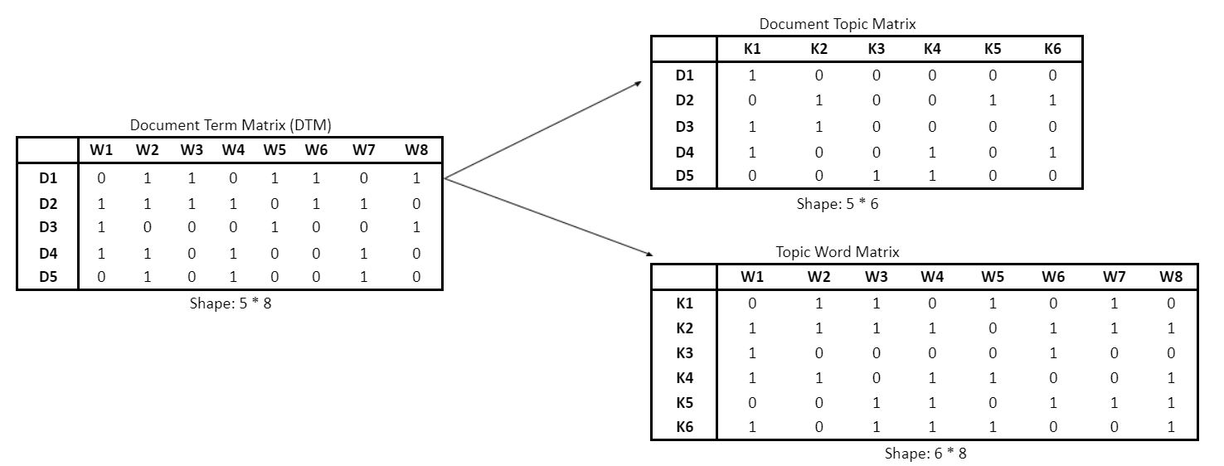
Latent Dirichlet Allocation (LDA)
Blei, D.M., Ng, A.Y. and Jordan, M.I., 2003. Latent Dirichlet allocation. Journal of machine Learning research, 3(Jan), pp.993-1022.

Slide 43
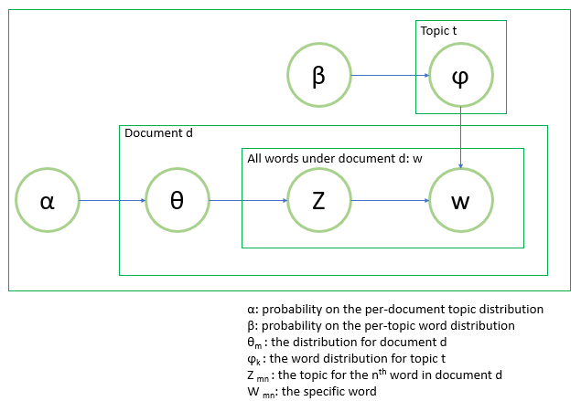
Latent Dirichlet Allocation (LDA)
Notes:
Initialization: Initially, the number of topics, K, needs to be specified. This is a hyperparameter that determines the desired number of topics to be extracted from the documents.
Algorithm Iterations: LDA employs an iterative process to estimate the topic distributions and word distributions. The steps are as follows:
a. Random Assignment: Each word in each document is randomly assigned to one of the K topics through a prior Dirichlet distribution.
b. Topic Distribution Estimation: LDA then iterates through each word in each document and estimates the probability of that word belonging to each topic, based on the current assignments of all other words. This estimation is performed using Bayesian inference and statistical techniques.
c. Topic Assignment Update: Using the probabilities obtained in the previous step, LDA updates the topic assignments for each word, considering the likelihood of the word belonging to different topics.
d. Iteration: Steps b and c are repeated multiple times until convergence is reached, meaning the topics and word distributions stabilize.
Topic Inference: Once the algorithm has converged, LDA outputs the inferred topic distributions and word distributions. Each topic is represented as a probability distribution over words, indicating the likelihood of each word occurring in that topic.

Slide 44
Latent Dirichlet Allocation (LDA)
LDA, on the other hand, is a generative probabilistic model that uses Bayesian inference to discover the underlying topics in a corpus of text.
It is based on the assumption that each document is a mixture of a small number of latent topics and that each word in the document is generated by a particular topic.
LDA creates a representation of the text that captures the underlying topics and the relationships between words and topics.
In short, LSA tries to discover underlying relationships between words, while LDA tries to discover underlying topics in a corpus of text. Both techniques can be used to create vector representations of text, but they have different underlying assumptions and are used for different tasks.
Blei, D.M., Ng, A.Y. and Jordan, M.I., 2003. Latent Dirichlet allocation. Journal of machine Learning research, 3(Jan), pp.993-1022.
Notes:
https://www.analyticsvidhya.com/blog/2021/06/part-2-topic-modeling-and-latent-dirichlet-allocation-lda-using-gensim-and-sklearn/
Interpretability: LDA provides better interpretability compared to LSA. LDA assigns meaningful labels to the discovered topics based on the probability distribution of words within each topic. This makes it easier for humans to understand and interpret the topics, as they are represented by the most relevant and representative terms.
Handling of polysemy and synonyms: LDA can handle polysemy (multiple meanings of a word) and synonyms more effectively than LSA. LDA models topics as probability distributions over words, allowing a word to have different probabilities in different topics. This allows LDA to capture the nuanced semantic relationships between words and assign them to appropriate topics based on their context, whereas LSA may struggle with such complexities.
Incorporation of prior knowledge: LDA allows the incorporation of prior knowledge or metadata about documents. It can consider document-level metadata (such as author, date, or source) or external knowledge sources to enhance the topic modelling process. This capability enables the inclusion of domain-specific information and can improve the quality and relevance of the topics generated.
Scalability and efficiency: LDA is generally more scalable and efficient than LSA when dealing with large text corpora. LDA uses a generative probabilistic model and efficient inference algorithms (such as variational inference or Gibbs sampling) to estimate the topic distributions. These techniques make LDA more suitable for handling large-scale datasets compared to the matrix factorization approach used in LSA.
Temporal analysis: LDA can be extended to handle temporal dynamics and topic evolution over time. By incorporating time stamps or considering document order, dynamic topic models based on LDA can capture how topics change and shift over different time periods. This temporal analysis is not inherent in LSA, which treats all documents equally and does not account for changes in topic distribution.

Slide 45
Lunch break

Slide 46
Session 3. Topic Modelling and Outcomes
Agenda
Recap questions (10 mins)
Training model and some important parameters(10 mins)
Hyperparameter Tuning – Select the best number of topics (10 mins)
Extracting and visualising outcomes (20 mins)
10-minute break
A full pipeline of topic modelling from scratch (60 mins)

Slide 47
Recap Questions (5 mins)
Why do we need to clean the text data carefully and in a customisable fashion?
Name some steps in text pre-processing
What is n-grams model?
Why do we remove stop words?
What are differences between lemmatization and Porter Stemming?
What are differences between LSA and LDA?

Slide 48
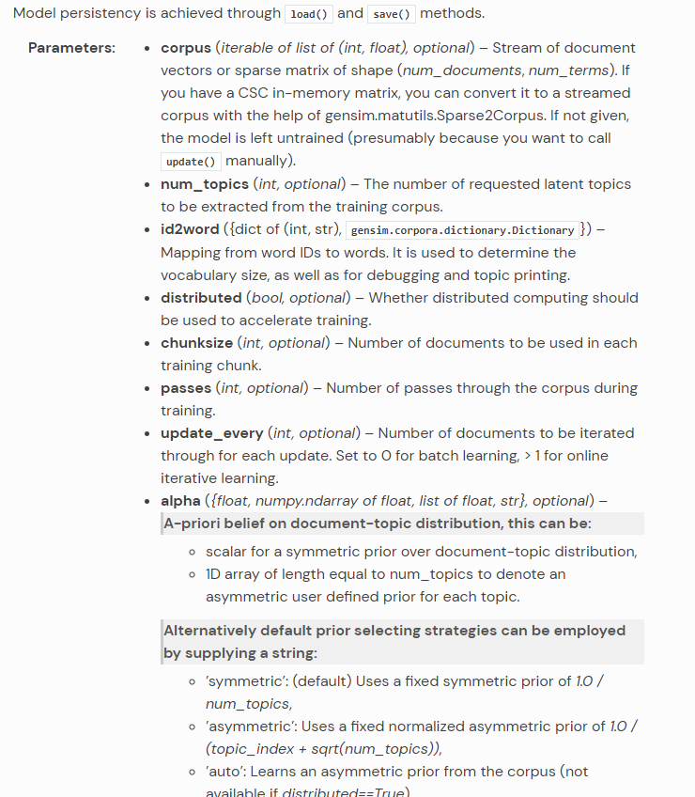
LDA Gensim Requirements
https://radimrehurek.com/gensim/models/ldamodel.html

Slide 49
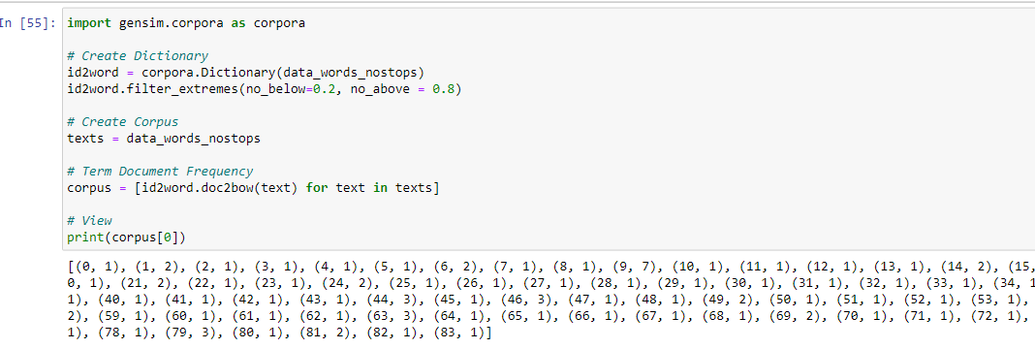
LDA with Python
Preparing data for fitting…
A dictionary
List of texts
A term document frequency

Slide 50
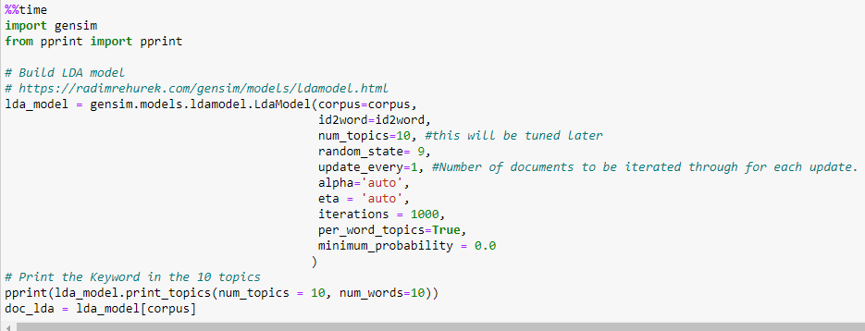
LDA with Python
Run the model – Important Parameters
https://radimrehurek.com/gensim/models/ldamodel.html
Corpus
Id2word
Num_topics
Random_state
Alpha
Eta
Etc.

Slide 51
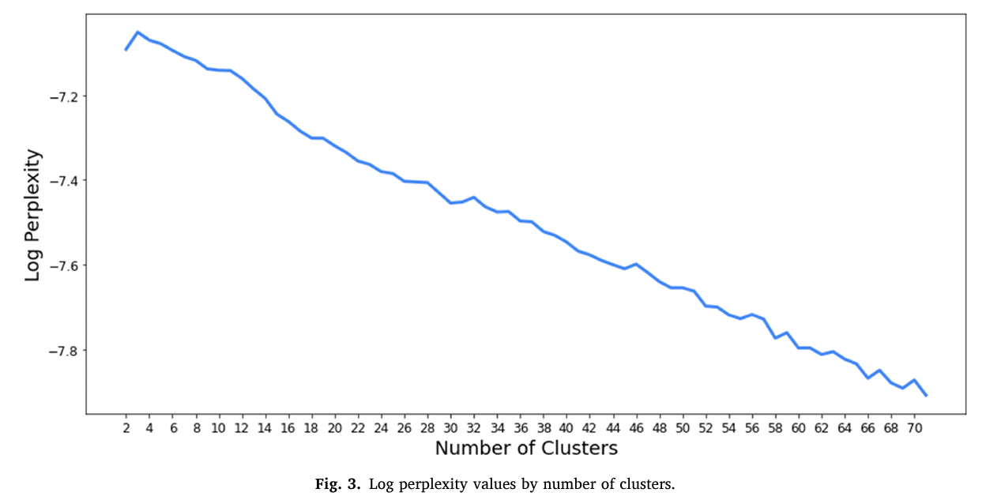
Quality of a K number of topics and Hyperparameter Tuning
Log Perplexity Score from the original authors
Hoffman, M., Bach, F. and Blei, D., 2010. Online learning for latent dirichlet allocation. advances in neural information processing systems, 23.
Notes:
Perplexity score (Blei et al., 2003; Hoffman et al., 2010) is one of the intrinsic evaluation metrics which is widely employed by many researchers and analysts to find the optimal number of topics. The rationale behind the perplexity score is to compute the value of a held-out test set (unseen data) to measure the model fit. The lower the perplexity score, the better the model is.
However, Gensim Python package does not explicitly calculate the value of perplexity. Instead, they take log of perplexity, thus metrics for identifying the optimal number of topics would be “- Bound”. Hence, the value of log perplexity will be decreasing with perplexity which means that the higher log perplexity is, the more likely the model fits with the dataset. There for Eq. (6) can be converted to:
$$﻿Log perplexity ≤ −Bound$$
Perplexity is a widely used evaluation metric for topic models, but it is important to note that it has some limitations. It assumes that the test data is generated from the same distribution as the training data, which may not always be the case. Additionally, perplexity alone may not capture all aspects of model quality, such as semantic coherence or meaningful topic representations. Therefore, it is often recommended to use perplexity in conjunction with other evaluation measures when assessing the performance of an LDA topic model.
The perplexity score provides an indication of how well the LDA model generalizes to unseen documents. Lower perplexity values indicate better performance, as they imply that the model is more confident in predicting the observed test documents. Higher perplexity values suggest that the model is less certain about the test data, indicating poorer performance.

Slide 52
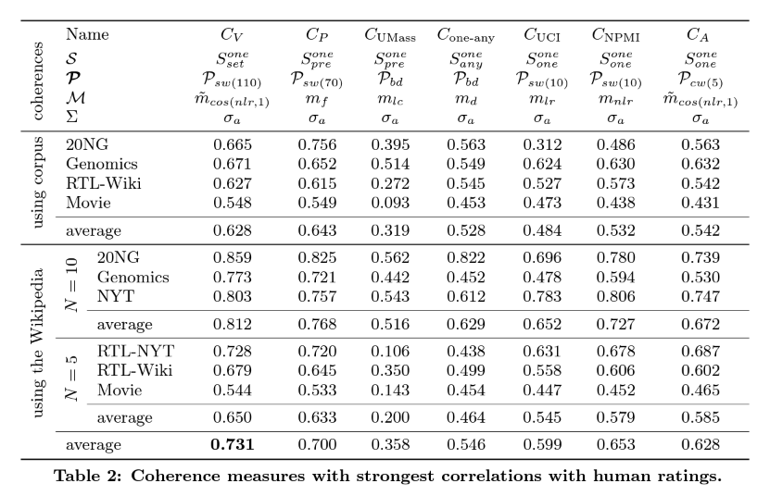
Coherence score
https://radimrehurek.com/gensim/models/coherencemodel.html
Röder, M., Both, A. and Hinneburg, A., 2015, February. Exploring the space of topic coherence measures. In Proceedings of the eighth ACM international conference on Web search and data mining (pp. 399-408).

Slide 53
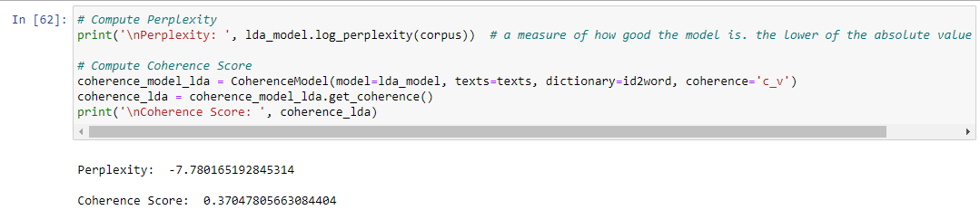
Extracting Coherence and Perplexity score from trained model

Slide 54
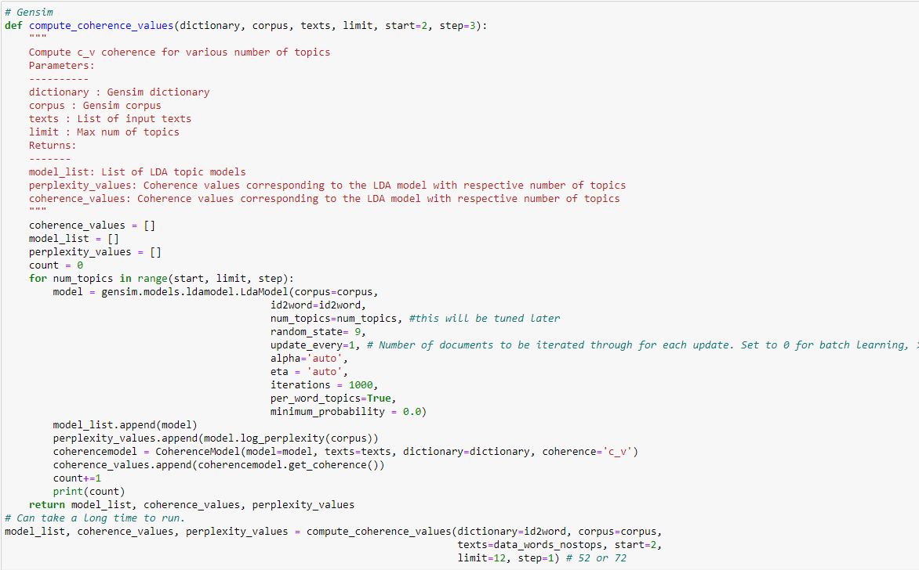
Tuning Number of Topics
Be careful when selecting the range of K topics:
Small numbers: Overly broad topics
Large numbers: Too specify and overlapping but not semantically meaningful
Chae, B. and Olson, D., 2021. A topical exploration of the intellectual development of decision sciences 1975–2016. Decision Sciences, 52(3), pp.543-566.
Notes:
Parameters of LDA
Alpha and Beta Hyperparameters – alpha represents document-topic density and Beta represents topic-word density. Higher the value of alpha, documents are composed of more topics and lower the value of alpha, documents contain fewer topics. On the other hand, higher the beta, topics are composed of a large number of words in the corpus, and with the lower value of beta, they are composed of few words.
Number of Topics – Number of topics to be extracted from the corpus. Researchers have developed approaches to obtain an optimal number of topics by using Kullback Leibler Divergence Score. I will not discuss this in detail, as it is too mathematical. For understanding, one can refer to this^{[1]} original paper on the use of KL divergence.
Number of Topic Terms – Number of terms composed in a single topic. It is generally decided according to the requirement. If the problem statement talks about extracting themes or concepts, it is recommended to choose a higher number, if problem statement talks about extracting features or terms, a low number is recommended.
Number of Iterations / passes – Maximum number of iterations allowed to LDA algorithm for convergence.
Topics are good when they are semantically coherent and distinguishable from one another. Choosing too few K results in overly broad topics, while high K leads to very specific, but not semantically meaningful, topics.

Slide 55
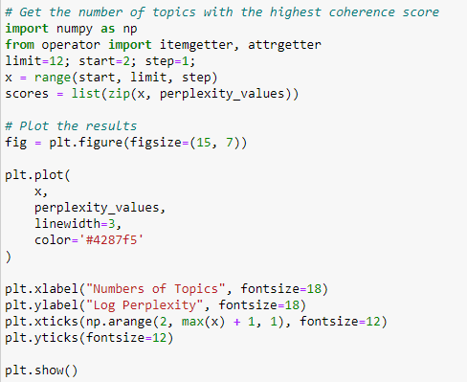
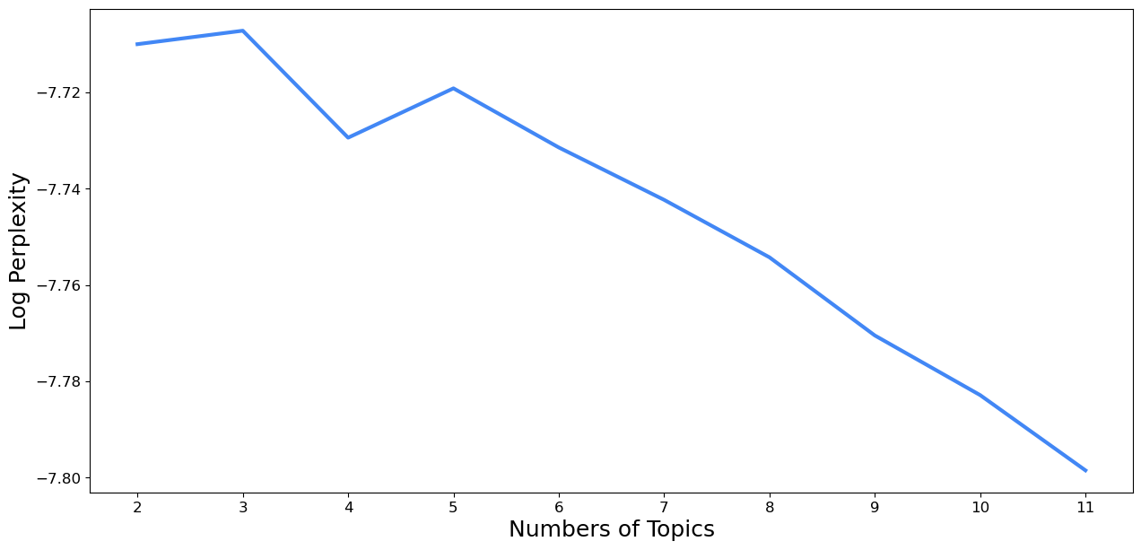
Perplexity Score

Slide 56
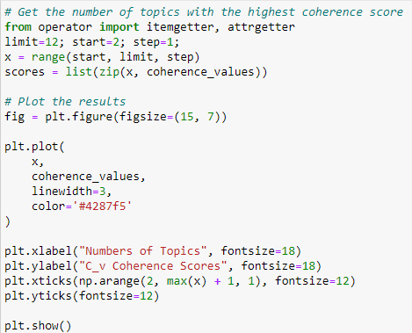
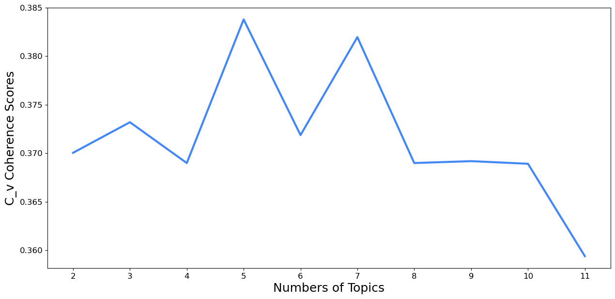
Coherence Score

Slide 57
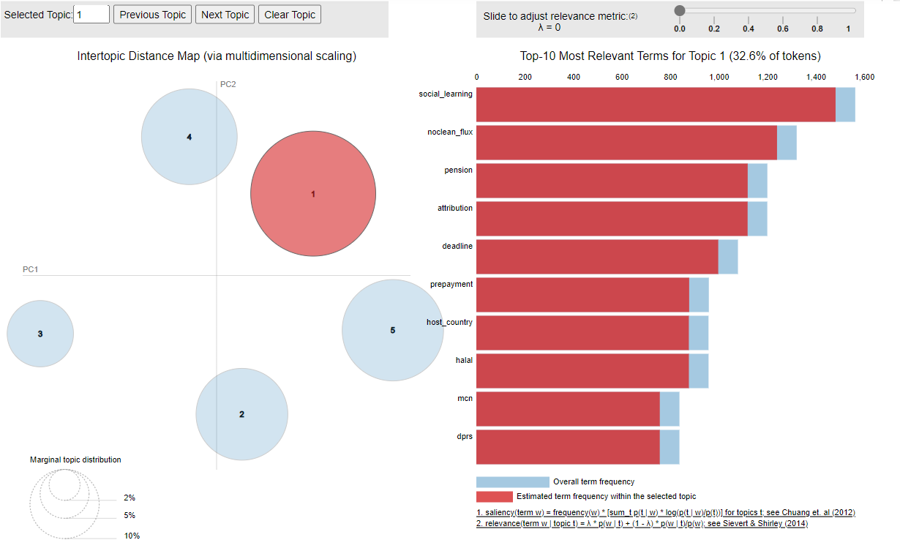
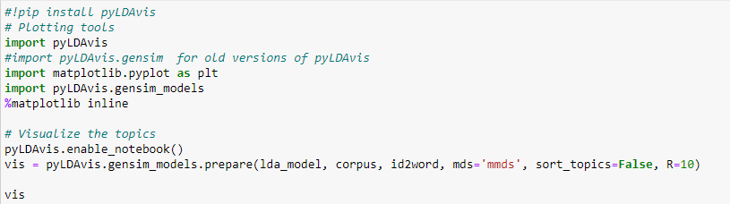
Topic visualisation – pyLDAvis
API documentation — pyLDAvis 2.1.2 documentation
Sievert, C. and Shirley, K., 2014, June. LDAvis: A method for visualizing and interpreting topics. In Proceedings of the workshop on interactive language learning, visualization, and interfaces (pp. 63-70).

Slide 58
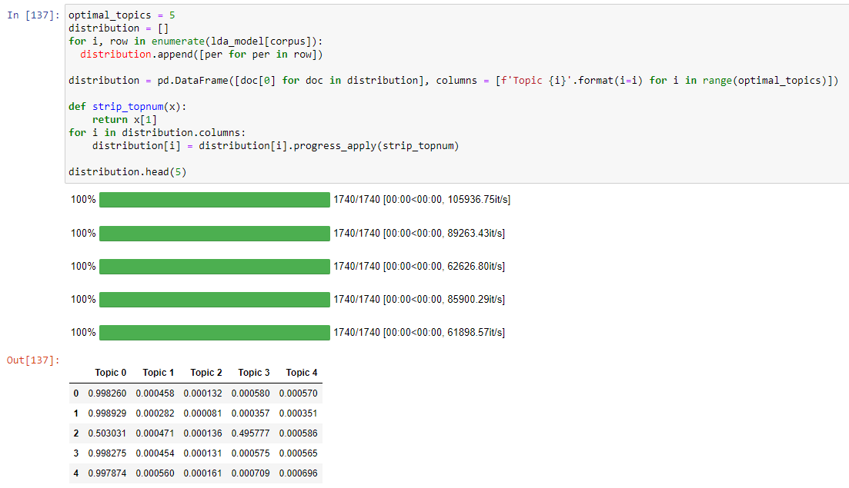
Get topic distribution per document

Slide 59
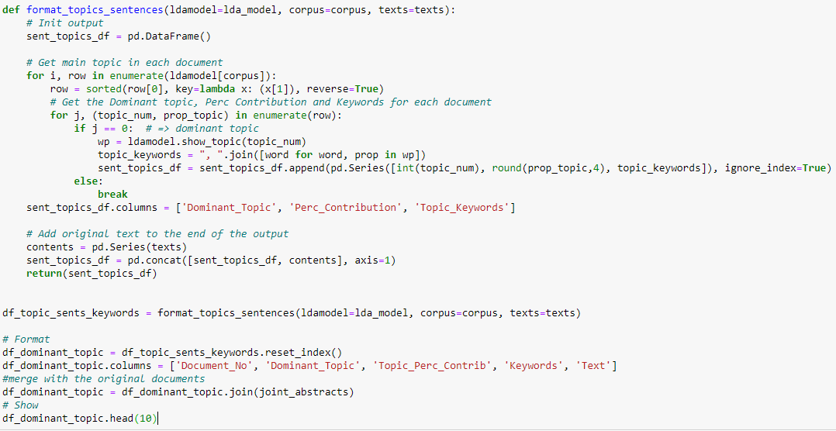
Get table of topic assignment

Slide 60
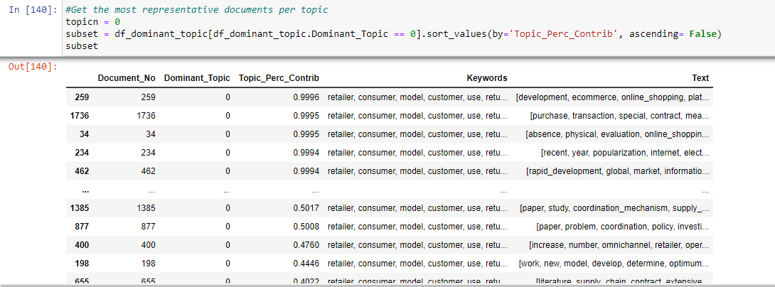
Get the most representative documents per topic

Slide 61
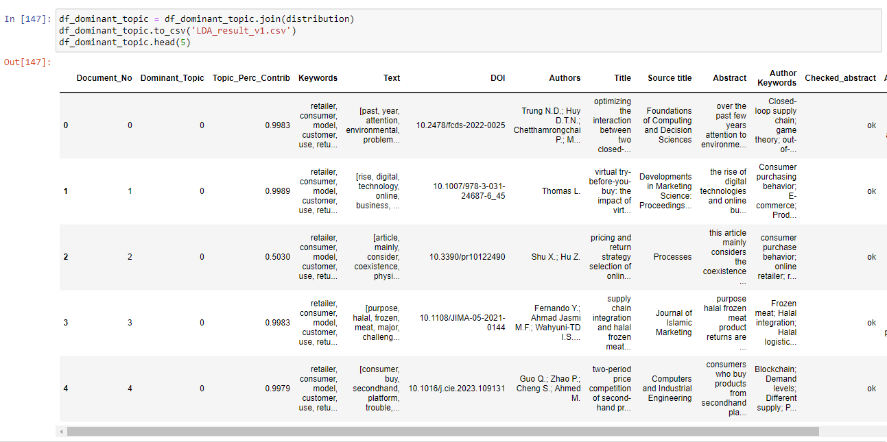
Save the final document

Slide 62
Learning Outcomes
Holistically diagnose the sources of noises and challenges from unstructured abstract data - (Session 1)
Design a customised pipeline of text processing methods to address the noises and produce a ready-to-use collection of documents (i.e., corpus) - (Session 1-2)
Employ topic modelling for identifying the prevailing themes in your research domain - (Session 2-3)
Visualise the extracted topics on a semantic space - (Session 2-3)
Notes:
About With the proliferation of academic databases, manual thematic/content analysis is no longer effective to cover all papers and extract common topics. To cope with that issue, machine learning-based topic modelling is a well-known technique to explore prominent topics from a big collection of texts. This course aims to provide a basic knowledge about text pre-processing and an introduction of the most common topic model – Latent Dirichlet Allocation (LDA) using the Python-programming language. The participants will have an opportunity to practise on real academic dataset.

Slide 63
Some more advanced techniques
LDA MALLET
LDA+BERT
Hierarchical LDA (tomotopy package)
Dynamic LDA
Multi Grain LDA
Panchinko Allocation
BerTopic

Slide 64
Tutorial task (1 hour)
Task: Collect two sets of abstracts using your own keywords of your own research projects (Scopus and WoS). Upload them to your Google Drive and load them to Google Colab. Please apply the learnt pipeline of text cleaning into your datasets.
Pipeline:
Download and upload data
Inspecting, merging and removing duplications
Checking missing values
Extract the abbreviations
Define a customised function
Expand the contractions
Collocation detection (bigrams and trigrams)
Stop word removals
Lemmatisation

Slide 65
Run LDA model on your cleaned dataset
Pipeline:
Prepare required data format
Run a test model with a random number of topics
Tune the number of topics using perplexity and coherence score and visualise
Retrain the model with the optimal number of topics
Visualise topics using pyLDAvis
Extract topic assignment, topic distribution and representative document per topic
Tutorial task (1 hour)

Slide 66

Thank you very much for your attention!
Any questions?

